Slide 1

Detecting Fraudulent Automobile Insurance Claims Using Machine Learning
Student ID – UP2147594

Slide 2

Introduction
In 2022, the UK insurance industry contributed £17.2 billion, 2.1% of total tax receipts, per the ABI.
Fraudulent claims, especially in motor insurance, made up 57% of all claims in 2021.
Current methods for detecting fraudulent claims often rely on manual review. They are slow, biased and resource intensive.
Machine Learning offers an alternative. It can analyse information with speed and accuracy by leveraging vast datasets and algorithms.
Source – Fraudulent insurance claims in the UK by segment | Statista
Insurance claims fraud up by 13% in 2021 - Aviva plc
Background on: Insurance fraud | III

Slide 3
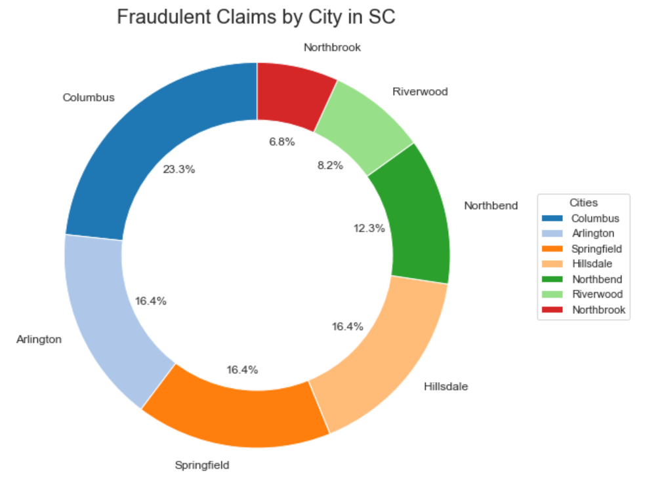
Insurance Industry & Fraud
The insurance industry plays a crucial role in the global economy and provides financial protection and risk management.
Insurance can be categorised into several types, based on the risks it underwrites. (Life, Health, Automobiles, Property, etc)
Insurance fraud has several negative effects on both the industry and consumers, leading to financial losses for insurers and higher premiums for policyholders.
Image - Fraudulent Claims by City in SC

Slide 4

Types of Insurance Fraud
Insurance fraud can be classified into hard fraud and soft fraud.
Hard Fraud: Staged accidents, deliberate injuries, or thefts for payout.
Soft Fraud: Exaggerating legitimate claims for higher compensation.

Slide 5
Machine Learning for Fraud Detection
Machine learning is capable of analysing large datasets to detect complex fraud patterns.
Types of Machine Learning
Supervised: Uses labeled data for fraud detection.
Unsupervised: Identifies anomalies in unlabeled data.
Semi-Supervised: Combines both labeled and unlabeled data.
Key Algorithms Used: Logistic Regression, Decision Trees, Random Forest,
Gradient Boosting, Support Vector Machines

Slide 6
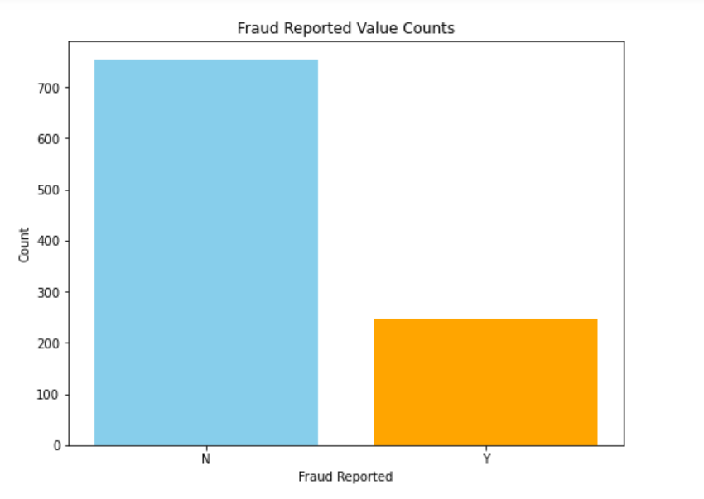
Dataset & Challenges
The dataset contains details of 1,000 claims: 247 Fraudulent
and 753 non-fraudulent claims.
One significant challenge is class imbalance. The fraudulent cases are typically much fewer compared to legitimate ones. This imbalance lead to biased models that focuses on the majority class.
The dataset also has a very high number of dimensionality with 40 different features. There are also some missing values
Image – Fraud Reported Value Counts from The Dataset

Slide 7
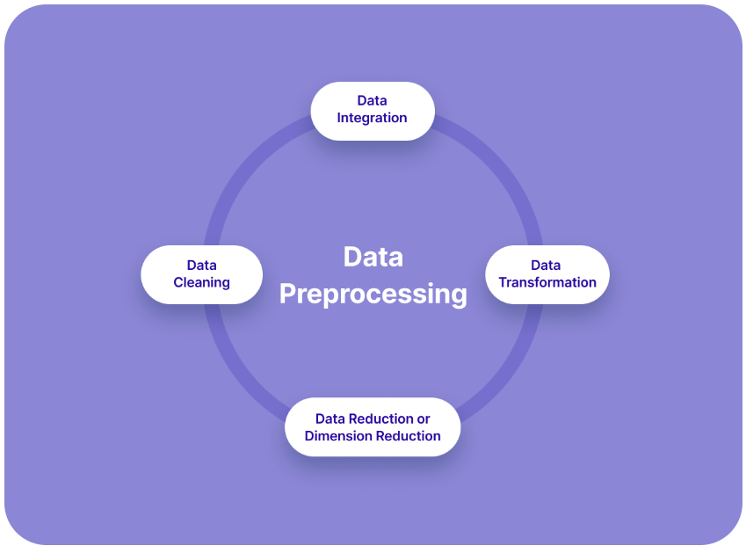
Data Preprocessing
Handling Missing Data: Used mode imputation.
Encoding Categorical Variables: Used one hot encoding method.
Removing Variables: '_c39,' 'total_claim_amount,' and 'age' were removed due to redundancy and multicollinearity.
Encoding Categorical Variables: Used one hot encoding method.
Image – https://www.v7labs.com/blog/data-preprocessing-guide

Slide 8
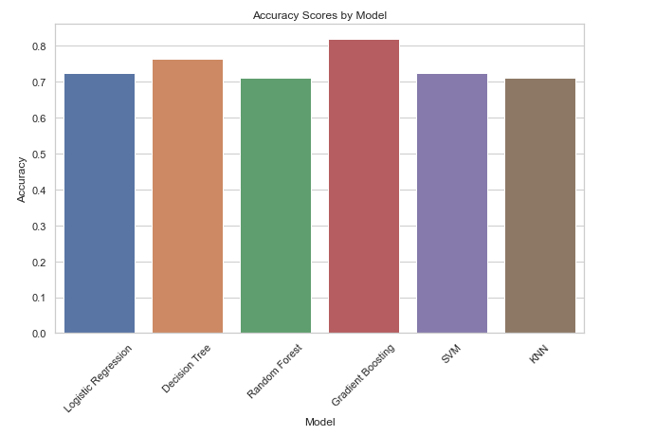
Model Selection
Models evaluated: Logistic Regression, Decision Trees, Random Forest, Gradient Boosting, SVM, KNN.
Gradient Boosting showed the best performance, It was then tuned with hyperparameters and class imbalance was addressed using SMOTE.
Image – Accuracy Score by Model from the Thesis

Slide 9
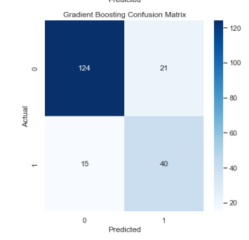
Model Evaluation Metrics
The evaluation function was used to compute performance metrics such as accuracy, precision, recall, F1 score, confusion matrix, and ROC AUC.
From the evaluation, Gradient Boosting emerged as the most affective model. It scored a precision of 0.66, recall of 0.73, and an F1 score of 0.69. The confusion matrix shows 124 true negatives, 21 false positives, 15 false negatives, and 40 true positives, indicating effective fraud detection.
I proceeded to further tune the Gradient Boosting model with optimised hyperparameters.
Image – Confusion Matrix Score of Gradient Boosting Model

Slide 10
Model Tuning & Key Results
Gradient Boosting was optimised using GridSearchCV and RandomizedSearchCV to enhance performance by exploring different hyperparameter combinations.
GridSearchCV found a conservative setup with a lower learning rate and deeper trees, while RandomizedSearchCV identified a more aggressive configuration with a higher learning rate and shallower trees.
These optimised hyperparameters significantly improved the model's ability to detect fraudulent insurance claims.

Slide 11
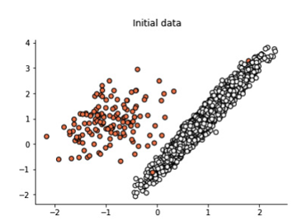
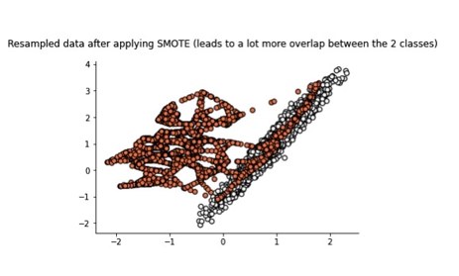
SMOTE Application
After optimising the Gradient Boosting model, SMOTE was applied to address the class imbalance, as fraudulent claims were only 25% of the dataset.
SMOTE helps balance the dataset, ensuring the model remains sensitive to underrepresented fraudulent claims.
I further tuned the SMOTE-adjusted Gradient Boosting model using RandomizedSearchCV with 20 iterations and 5-fold cross-validation to optimise key hyperparameters.
The model achieved 0.79 accuracy, 0.62 precision, 0.56 recall, and an AUC of 0.81, illustrating SMOTE has significantly improved the model
Image – Impact of SMOTE explained from the thesis

Slide 12
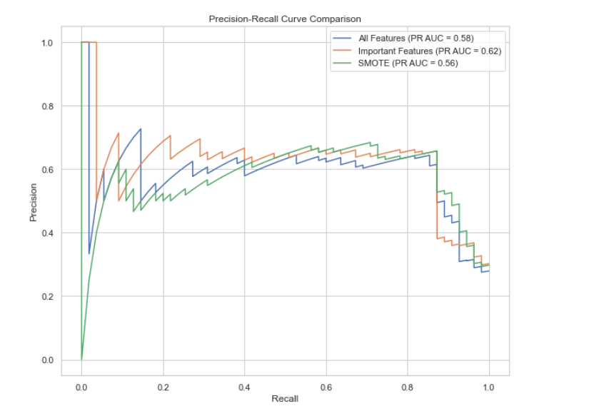
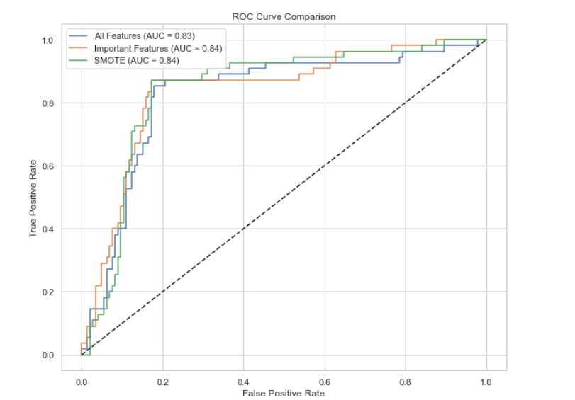
Feature Importance & Model Comparison
Key Features Impact: Accuracy improved to 0.81, with 0.66 precision and 0.60 recall, focusing on top predictors like incident severity.
All Features : Accuracy was 0.79, with 0.62 precision and 0.55 recall.
Conclusion : Key features, boosted accuracy and precision for better fraud detection
Image – ROC and Precision Curves Comparison from the thesis

Slide 13
Conclusion and Recommendations
Gradient Boosting Model with SMOTE, is a highly effective tool for detecting fraudulent claims.
The model has the ability to improve fraud detection, reduce financial losses for insurers can lead to more sustainable pricing models.
More accurate model training could be achieved by improving dataset labelling.
Exploring real-time fraud monitoring with machine learning models, combined with further refinement through deep learning techniques, can significantly enhance the effectiveness of fraud detection.

Slide 14
Scope of Future Work
Advanced Techniques: Explore deep learning for complex pattern detection and improved accuracy.
Real-Time Detection: Implement real-time fraud detection systems using live data streams.
External Data Integration: Enhance models with external data (social media, criminal records) for robustness.
Explainable AI: Develop models that not only detect fraud but also provide transparent reasoning for decisions.

Slide 15
Ethical Considerations and Concerns
Bias Mitigation: Ensure fairness in models to prevent targeting of specific groups.
Data Privacy: Handle sensitive data with care, adhering to GDPR/CCPA regulations.
Avoid Negative Impacts: Monitor and audit models to prevent unintended exclusions or barriers for vulnerable populations.

Slide 16
Thank you

